Slide 1
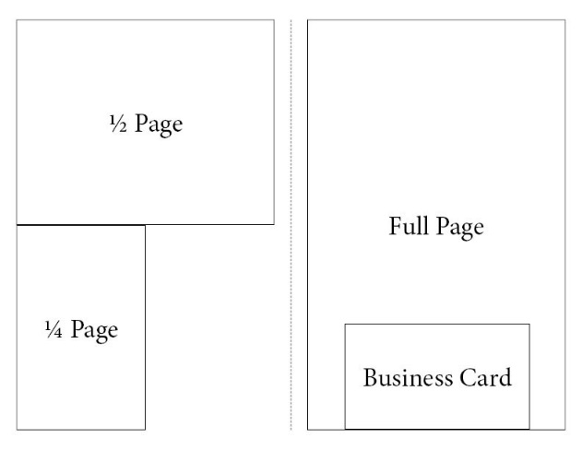
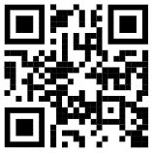
Harris County Touchdown Club
2023 Football Program
Ad Purchase Form
Complete the online ad form and submit payment to the HCTD Club no later than July 20, 2023.
You may also complete this form online at www.hctdclub.com.
Payments may be mailed to the HCTD Club at PO Box 129, Hamilton, GA 31811.
Payments may also be given to a club officer
(must be postmarked by 7/20/23 if mailed).
Preferred formats for ads are Vector Files (.pdf, .eps, .ai, .svg are acceptable). If there are questions, please contact Lisa Scully at 706-366-7653. Completed camera ready artwork must be submitted – design services are not available for business ads.
Football Program Ad Options:
Inside Cover: 8 ½ x 11 (Color) $350
Full-Page: 7 ¼ x 9 (Color) $250
Full-Page : 7 ½ x 9 (Black & White) $150
Half-page: 7 ½ x 4 ½ (Black & White) $100
Quarter Page: 3 5/8 x 4 ½ (Black & White) $50
Business Card: (Black & White) $30
Tiger Package: $400
Full-Page Color Ad, 24 in. Sign Board Color Ad,
2 Season Football Passes
Sign Options:
Sponsor Board Signs (entrance to Tiger Stadium):
48” wide x 36” tall, color $275 ($250 renewal)
24” wide x 18” tall, color $150 ($125 renewal)
Modstar Frame Field Sign (yard line signs) $600 ($450 renewal)
4 feet, color, 2 Season Football Passes
Tiger Tron Scoreboard Ad Packages:
Commercial Ad Package: (Not Available) $500
3 :30 second commercials per game to air on video board during all 2023 varsity games including playoff games at Tiger Stadium
Custom Ad Panel: $1,250
4’ wide x 33” tall Ad Panel - will remain for two years
Full-Page black & white ad in football program
2 entitlement announcements per game
2 season football passes (optional)
Custom Ad Panel: $5,000
6’ wide x 6’5” tall Ad Panel – will remain for Three years
Full-Page black & white ad in football program
4 entitlement announcements per game
4 season football passes (optional)
Visit http://tinyurl.com/HCTCAds or scan the QR code to complete online!

